Slide 1

The Wireless Bird
The Little Spotted Kiwi Image Capturing Device
Created By:
Emmanuella Emmanuel
Sammantha Firestone
Anthony Gibertii
Ariel Gonzalez
Thach Pham
Wentworth Institute of Technology
April 18th, 2013

Slide 2
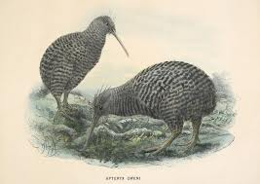
The Little Spotted Kiwi
One month ago, we were asked to design a product that would help researchers preserve the Little Spotted Kiwi bird population. The Little Spotted Kiwi bird is the second rarest species of flightless birds, and recently, the species’ population has been decreasing rapidly. Because of this, researchers want to identify and capture images of the Little Spotted Kiwi bird to determine the state of their health.

Slide 3
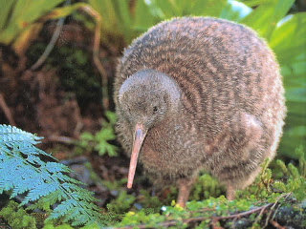
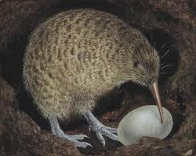
Outline
Problem Definition
Design Overview
Evaluation
Data
Analysis
Cost
Conclusion

Slide 4
Problem Definition
Client’s Conditions | N.S.E’s Conditions
Determine if the weight is over 1.75lbs Photograph and save an image of the Little Spotted Kiwi bird Identify the images of the Little Spotted Kiwi bird and discard any other images | Endure New Zealand’s weather/climate Flexible and portable Effective but at a affordable price

Slide 5
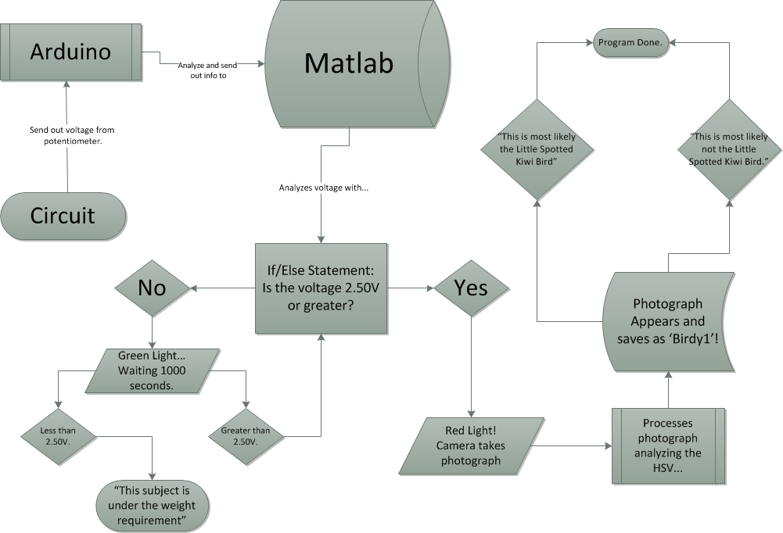
Design Overview

Slide 6
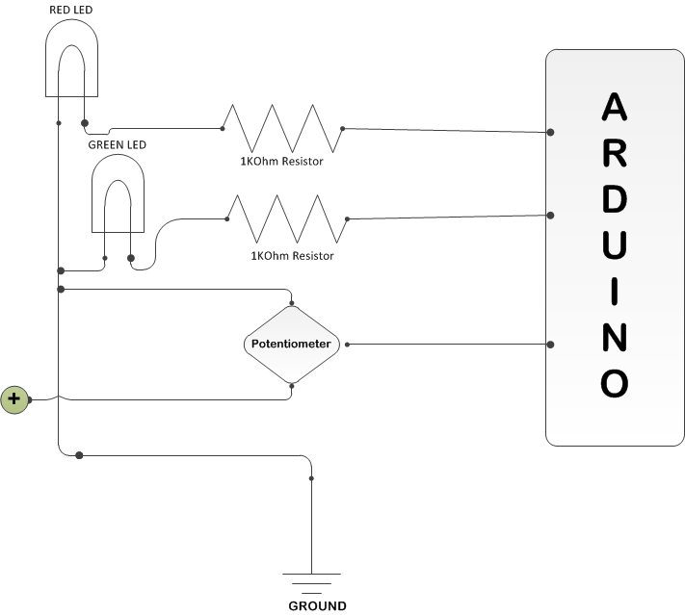
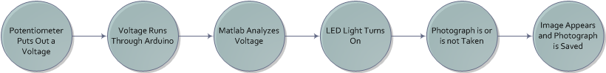
Design Overview
Improvements To Be Made
Remove LED lights
Add in Load Cell with amplifier
Obtain Wireless Arduino
Use CV31 Hi-Res Camera
Update Matlab coding
Add in reliable power source
Circuit diagram for the mock-prototype design
Flowchart of current mock-prototype design

Slide 7
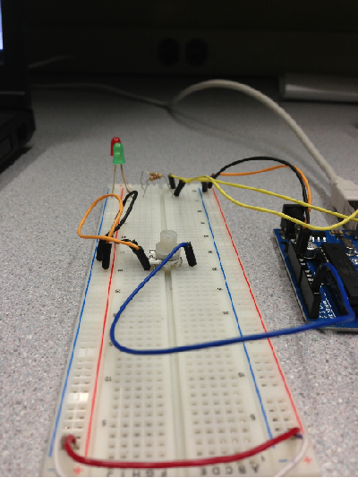
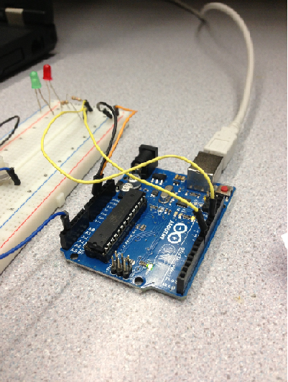
Evaluation of the Mock-Prototype
To evaluate the effectiveness of our mock-prototype we considered the following:
    The ability to determine if the weight is 1.75lbs or greater
    The ability to take a photograph
    The ability to identify the Little Spotted Kiwi Bird

Slide 8
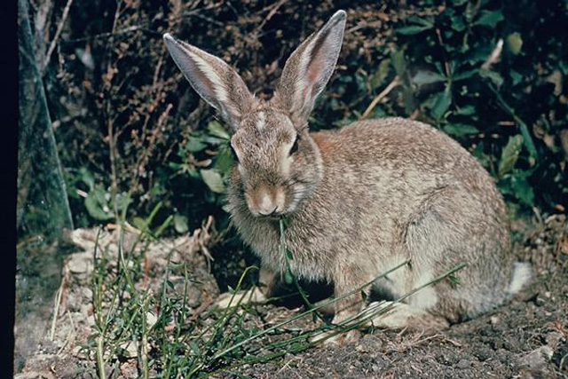
Data
Weight Requirement Test
Photo Analysis Test
Voltage Output | LED Light
0.00V | Green
0.50V | Green
1.00V | Green
1.50V | Green
2.00V | Green
2.50V | Red
3.00V | Red
Picture Name | Actual Animal | Little Spotted Kiwi? | C-Value
Kiwi.jpg | Little Spotted Kiwi | Yes | 170,585
Kiwi2.jpg | Little Spotted Kiwi | Yes | 274,570
Kiwi3.jpg | Little Spotted Kiwi | Yes | 127,414
Animal1.jpg | Parrot | No | 30,032
Animal2.jpg | Rabbit | No | 29,538
Animal3.jpg | Lizard | No | 3,333
Animal4.jpg | Possum | No | 59,657
Animal5.jpg | Rat | No | 22,682
Image of the Rabbit our Matlab program analyzes

Slide 9
Analysis
Weight Requirement Test:
Results: Read in and identified weights 1.75lbs and over in each instance we changed the voltage.
PASS
Photo Analysis Test:
Results: Differentiate between the Little Spotted Kiwi bird and other animals.
PASS

Slide 10
Discussion
Pros
Inexpensive & Effective
Simple & Versatile
Flexible & User-Friendly
Final Product will be weather-proof, portable, and fully-functional
Cons
Unreliable Power Source
Solution: Modified Minty Boost
Unreliable Camera
Solution: CV31 Camera
Matlab Programming Imperfection
Solution: Edit the program

Slide 11
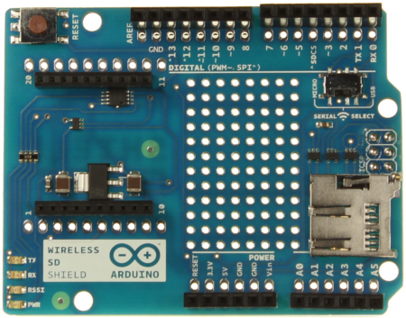
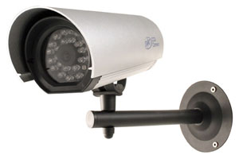

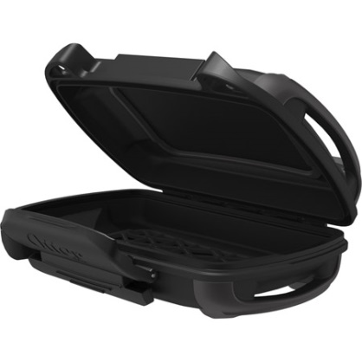
Field-Ready Product
Wireless & Portable
  Wireless Arduino
  Windows Tablet
  Modified Minty Boost
  CV31 Camera
Weather Resistant
  Otterbox
  CV31 Camera
The materials needed for the final product

Slide 12
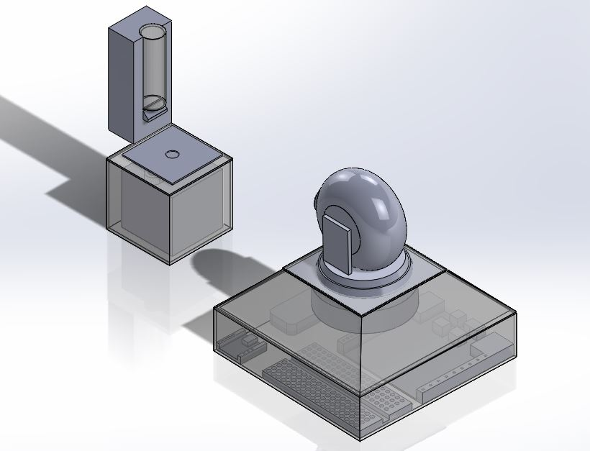
Field-Ready Product
Materials Needed:
>Breadboard
>Resistors
>Load Cell
>Amplifier
>Modified Minty Boost
>CV31 Camera
>Windows Tablet
>Otter box
>Matlab
>Wires

Slide 13
Cost
Mock-Prototype:
>Breadboard………………..$4.49
>Resistors…………………...$5.00
>Wires………………………$5.00
>Arduino……………………$39.95
>Lenovo Laptop w/ camera…$773.52
>Potentiometer………….......$2.00
>Matlab……………………..$2,150.00
Total Cost: $2,974.96
Field-Ready:
>Breadboard………………$4.49
>Resistors………………….$5.00
>Wires……………………..$5.00
>Arduino Wireless………..$30.46
>Camera…………………..$70.00
>Minty Boost……………..$35.00
>Windows Tablet…………$1,200.00
>Amplifier………………..$10.00
>Otterbox…………………$20.49
>Matlab……………………$2,150.00
>Load Cell…………………$585.00
Total Cost: $4,115.44

Slide 14
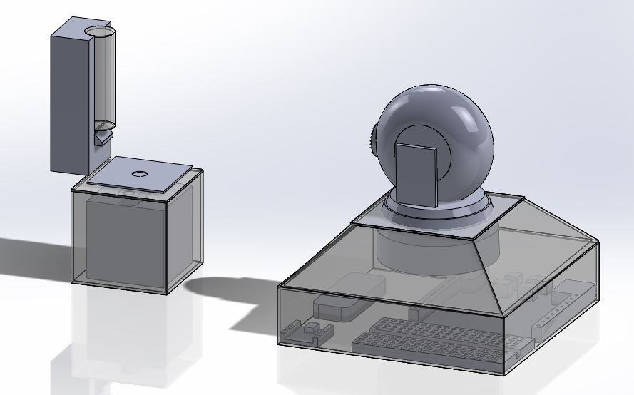
Conclusion
New Start Engineering aimed for the most effective, affordable device. Our mock-prototype shows the potential of our design. Hopefully, with enough funding and support, we can create the most effective product. We support the conservation and research of the Little Spotted Kiwi bird.

Slide 15
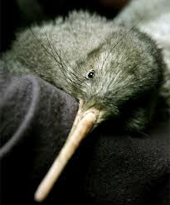
Questions?
“Each species on our planet plays a role in the healthy functioning of natural ecosystem, on which humans depend”
-William H. Schlesinger

